Slide 1

The Smart Resue Boat - Robotics
Lecturer- MR.Vimukuthi
Presented by – COHNDSE-017
COHNDSE-021

Slide 2

Agenda
The Problem & Solution Building confidence – Slide 01
System Hardware Architecture – Slide 02
Wiring & Connection Summary – Slide 03
Software Logic: The "Priority" Loop – Slide 04
Autopilot & Steering Logic – Slide 05
Critical Technical Challenges Overcome – Slide 05
Conclusion & Future Scope – Slide 06

Slide 3

The Problem & Solution

Slide 4

The Problem:
Traditional remote-controlled rescue boats require constant human line-of-sight and are prone to collisions in debris-heavy water.

Slide 5
Our Solution:
A smart vessel that can:
Be controlled via Bluetooth.
Automatically stop for obstacles.
"Return to Home" using GPS coordinates with zero user input

Slide 6

System Hardware Architecture

Slide 7
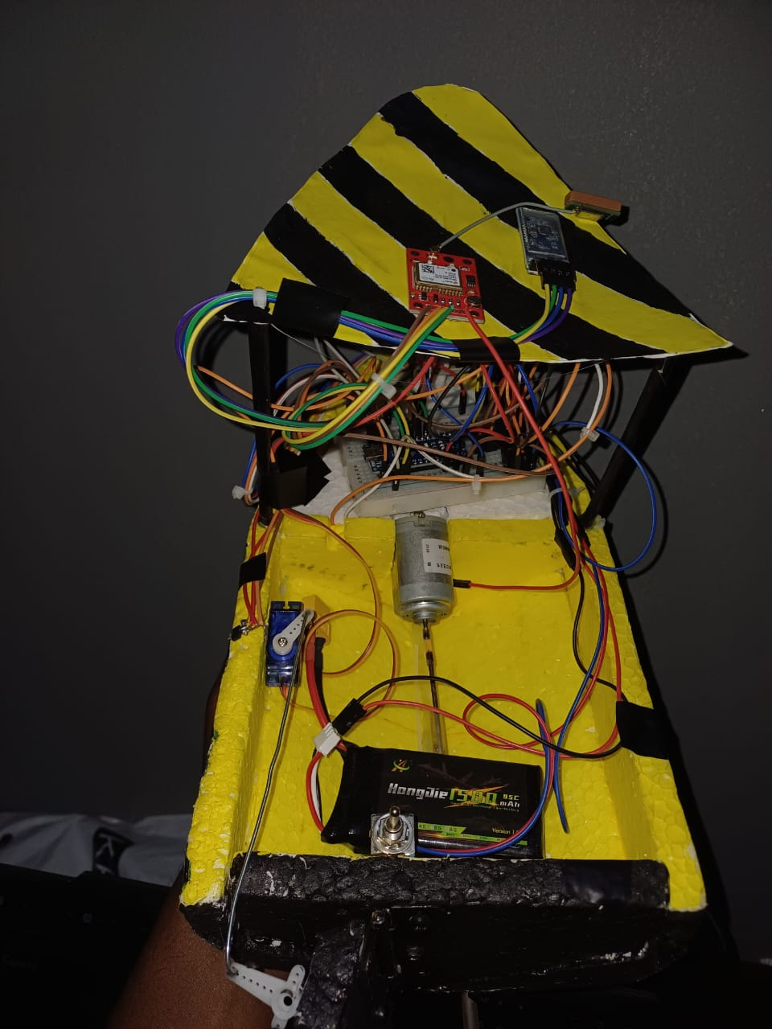
Hardware components and their usecases:
Microcontroller: Arduino Nano.
Communication: HC-05 Bluetooth (Serial control).
Navigation: NEO-6M GPS Module (Coordinate tracking).
Sensing: HC-SR04 Ultrasonic Sensor (Collision avoidance)
Output: L298N/L293D Driver (Propulsion) & MG995 Servo (Steering).

Slide 8
Wiring & Connection Summary

Slide 9
Wiring & Connection Summary
Serial Communication: * Bluetooth: Pins 2 (RX) / 3 (TX)
GPS: Pins A0 (RX) / A1 (TX)
Peripheral Control:
Ultrasonic: Pins 12 (Trig) / 13 (Echo)
Actuators: Pin 11 (Servo), Pins 5/6 (DC Motor)
Feedback: Pin 10 (Buzzer)

Slide 10
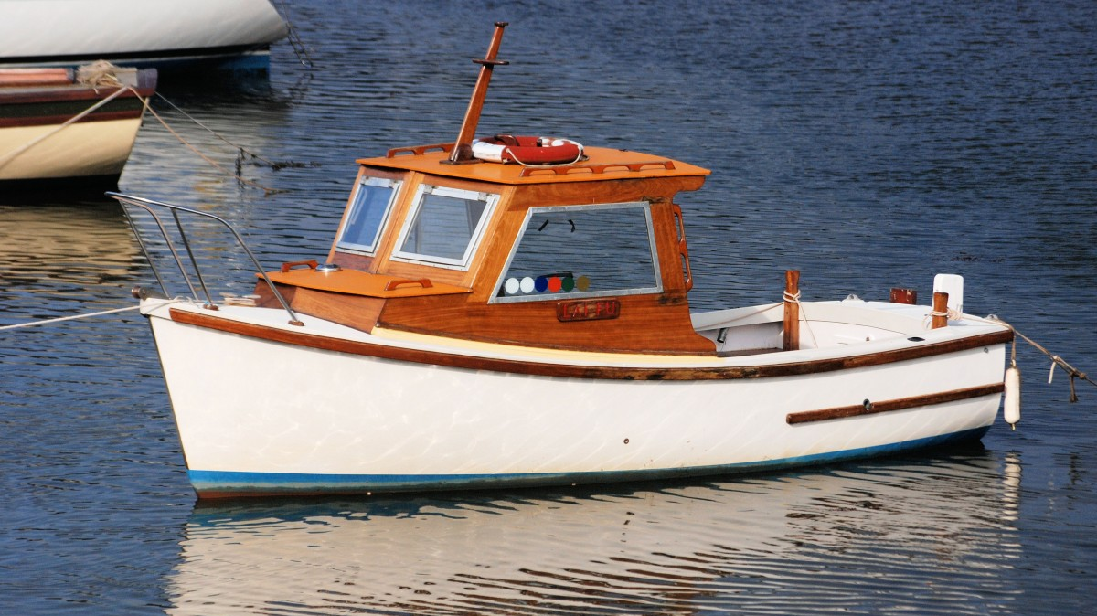
: Software Logic: The "Priority" Loop
This Photo by Unknown Author is licensed under CC BY-SA

Slide 11
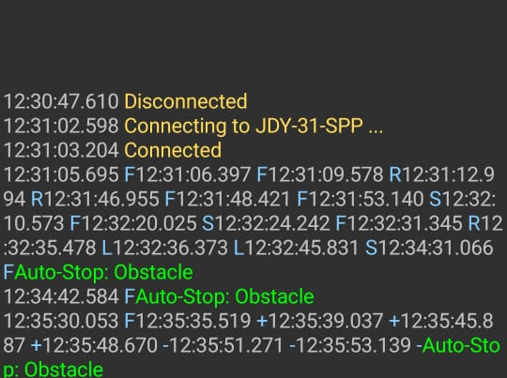
The "Priority" Loop
Level 1 (Highest): Safety. Ultrasonic check runs every cycle. If Distance < 25cm $\rightarrow$ EmergencyStop().
Level 2: User Input. Bluetooth commands take priority over autopilot to allow manual override.
Level 3: Navigation. GPS data is parsed in 80ms windows to prevent "Serial Blocking."

Slide 12

Autopilot & Steering Logic
This Photo by Unknown Author is licensed under CC BY-SA

Slide 13
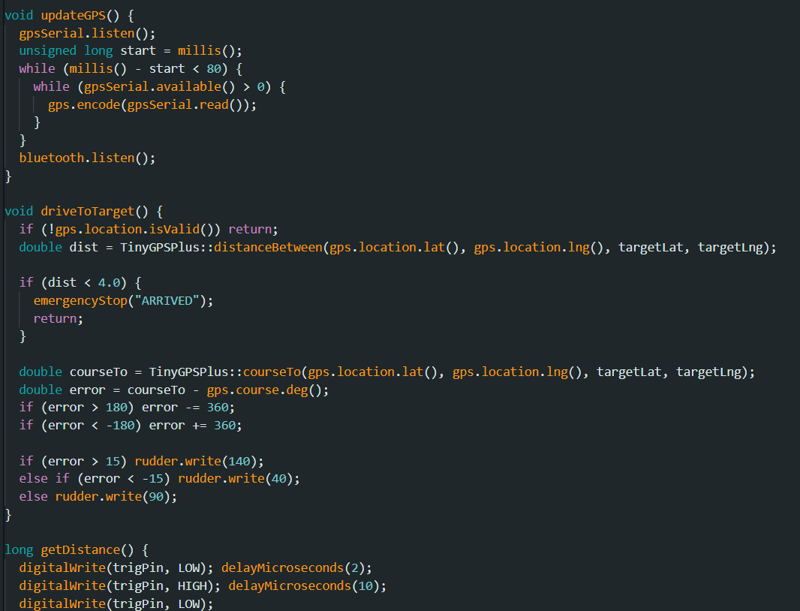
Autopilot & Steering Logic
Targeting: Saves current $Lat/Lng$ when "H" (Home) is pressed.
Heading Calculation: Compares current GPS heading with the bearing to the target.

Slide 14
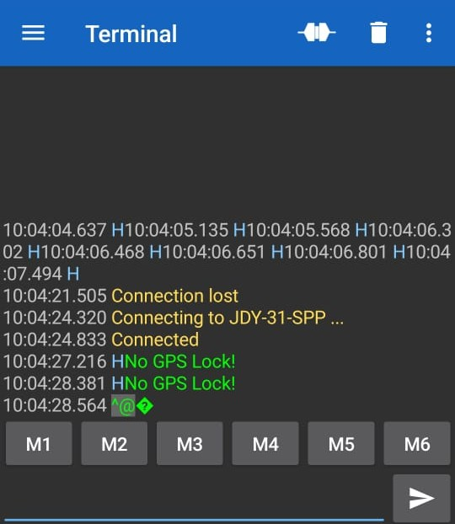
Terminal response when GPS engaged

Slide 15
Challenges Overcome
Serial Conflicts: Solved the "Freezing" issue by optimizing the GPS listening window to 80ms.
Mechanical Reliability: Implemented a "Kickstart" function to ensure the propeller starts under water resistance.
Logic Stability: Filtered out "Ghost Echoes" (0cm readings) from the ultrasonic sensor to prevent false stops.

Slide 16
Some of the existing challenges and issues
1. The "Indoor" Barrier (Most Common) :The module's red LED is solid or off, and the serial monitor says "No GPS Lock.“
The Fix: You must take the boat outside under an open sky.
2. The "Serial Conflict" (Software Issue) : When the GPS sends a long string of data, it blocks the Bluetooth. When the Bluetooth sends data, it blocks the GPS.

Slide 17
Future Enchancement
This Photo by Unknown Author is licensed under CC BY-SA

Slide 18
Enhancements planned to be done in future
Addition of an NRF24L01 for kilometer-range communication.
Integrating a First-Person View (FPV) camera for remote rescue.
Implementation of solar charging for extended battery life.
Integrating Compass/Magnetometer (HMC5883L / QMC5883L) instead of NEO-6M GPS module – gives the boat the sense of direction even when staying still
GPS + RTK (Real-Time Kinematics) – unlike standard NEO-6M which is accurate for only about 2.5-5m this sensor is accurate to 2cm

Slide 19

Thank you
COHNSE252F-017 : E.Danushyan
COHNDSE252F-019 : Rasindhu Yasas

